Slide 1
International Agreements

Slide 2
Defining International Treaties
A treaty is an international written agreement between nation states.
Governed by international law, treaties contain mutual understandings and intentions that help guide how nations relate to each other.

Slide 3
The Importance of International Treaties
With increased globalization, international treaties are becoming important - and important for Australia.
Australia is considered a “Middle Power” – it does not carry the weight of larger countries such as the US and China.
Negotiating international treaties allows Australia to have an international voice and prevent economic or strategic isolation.

Slide 4
Impact of International Treaties
When a nation signs an international treaty or convention, it is an expression of its political sovereignty (ability to make its own decisions).
Act of signing a treaty does not make it legally binding.
It becomes binding if the signatory nations change their laws to reflect the conditions of the treaty.
However, there is an expectation that the signatory nations will honour the commitment as closely as possible.

Slide 5
What is Heritage?
Notes:
https://www.youtube.com/watch?v=lOzxUVCCSug
https://www.nationalgeographic.com/travel/world-heritage/about/#close

Slide 6
A Major Treaty Signed by Australia

Slide 7
What is the World Heritage Convention?
Adopted in Paris, 16th November 1972. Australia became one of the first countries to ratify (confirm agreement with) the Convention in August 1974.
The Convention defines the kind of natural or cultural sites which can be considered for inscription on the World Heritage List.
The Convention sets out the duties of States Parties in identifying potential sites and their role in protecting and preserving them.
By signing the Convention, each country pledges to conserve not only the World Heritage sites situated on its territory, but also to protect its national heritage.

Slide 8
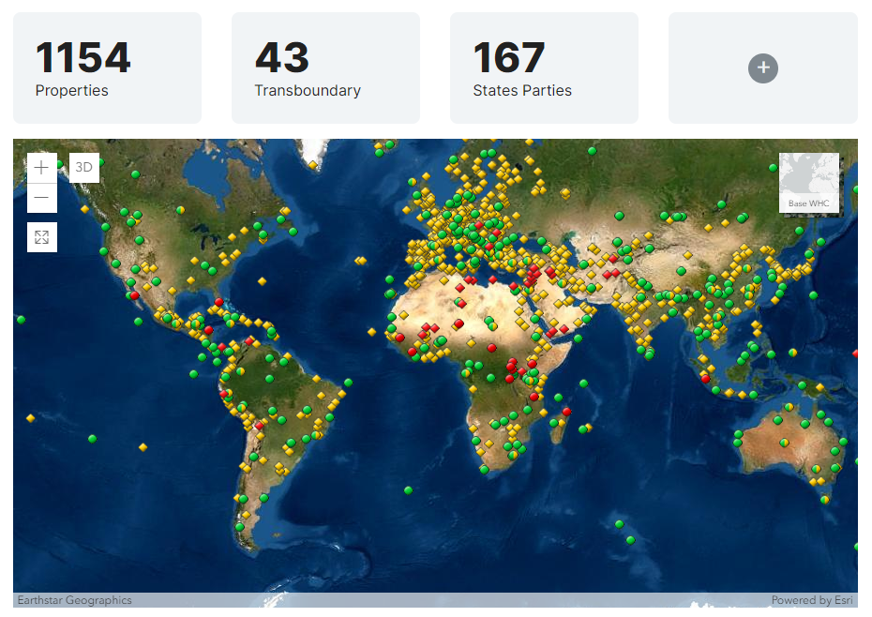
What is the World Heritage List?
Notes:
https://whc.unesco.org/en/list/

Slide 9
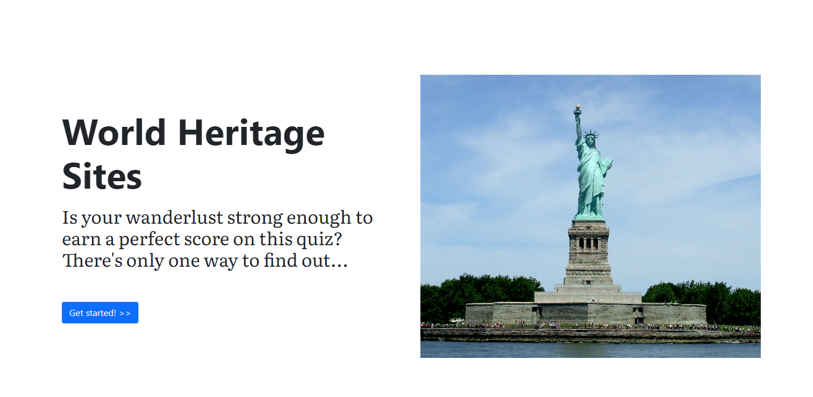
https://esri.github.io/treasure-hunt-app/?edition=heritage-sites
Notes:
https://esri.github.io/treasure-hunt-app/?edition=heritage-sites

